Slide 1
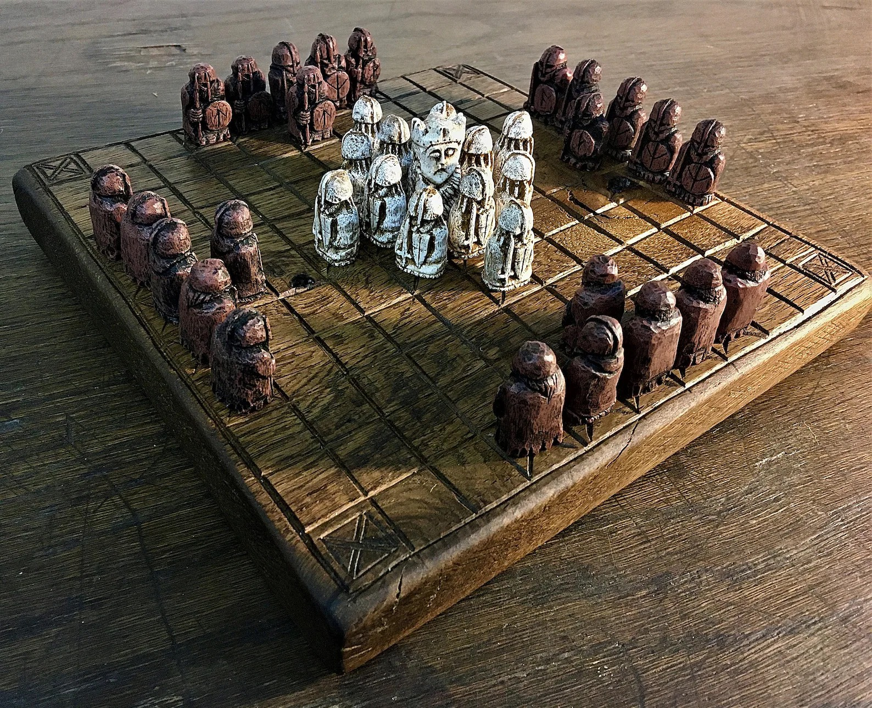
TABLUT CHALLENGE 2023
Christian Di Buò
Alberto Genovese
Simone Reale
Alessandro Tutone
by NordSudOvestEst

Slide 2
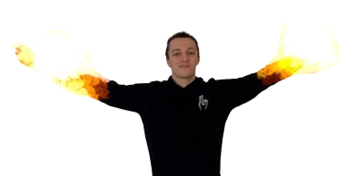


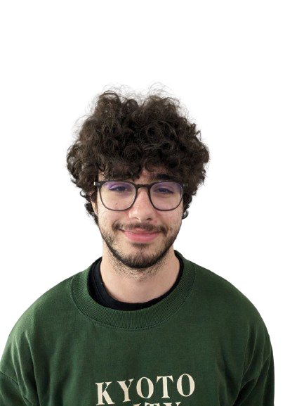
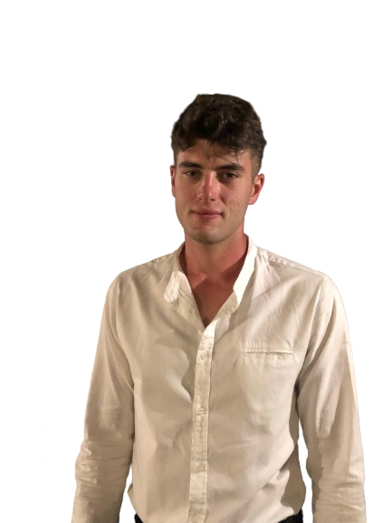
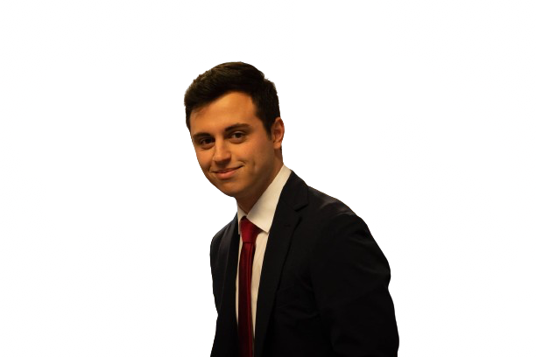
NSOE Team

Slide 3
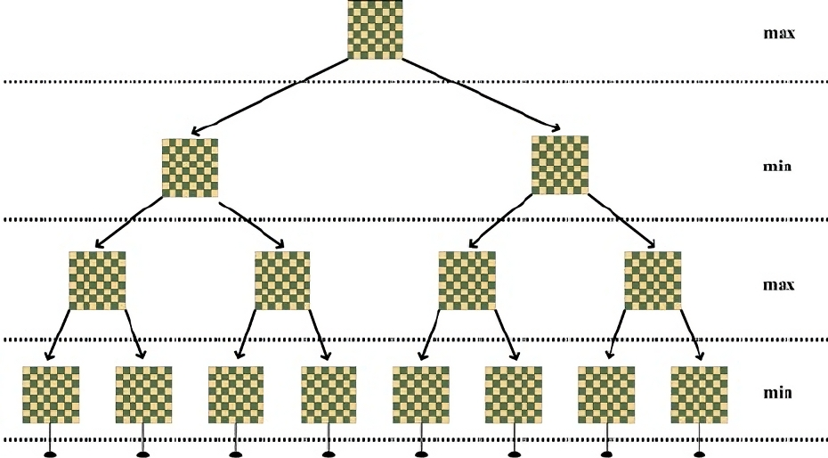
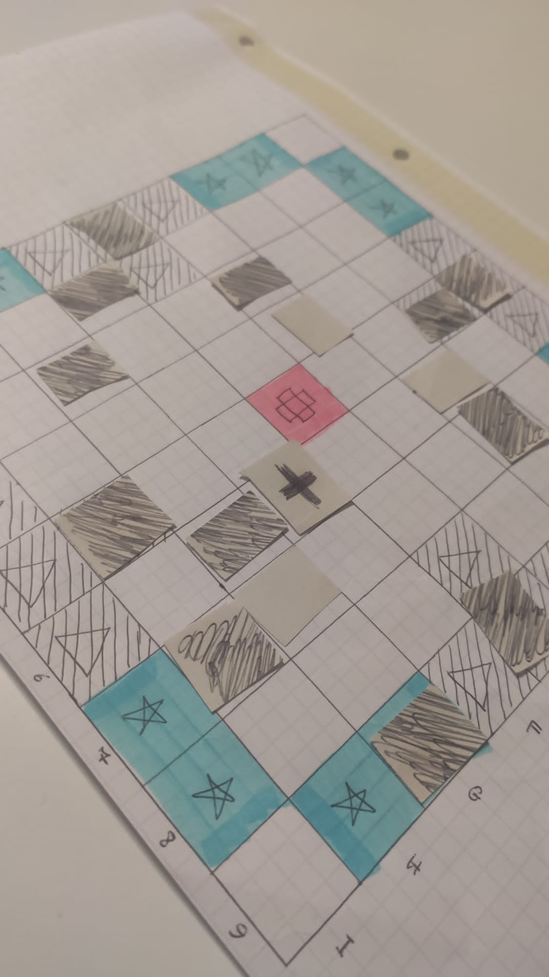
Our Strategy
Iterative deepening
Alpha-beta cuts

Slide 4
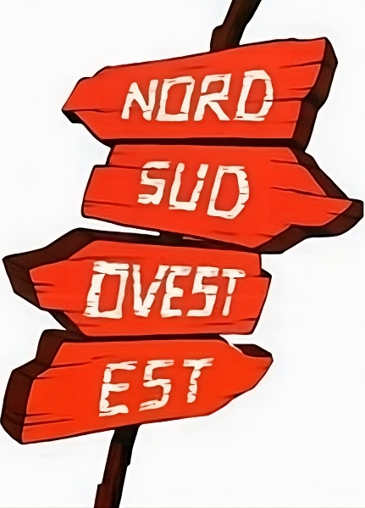

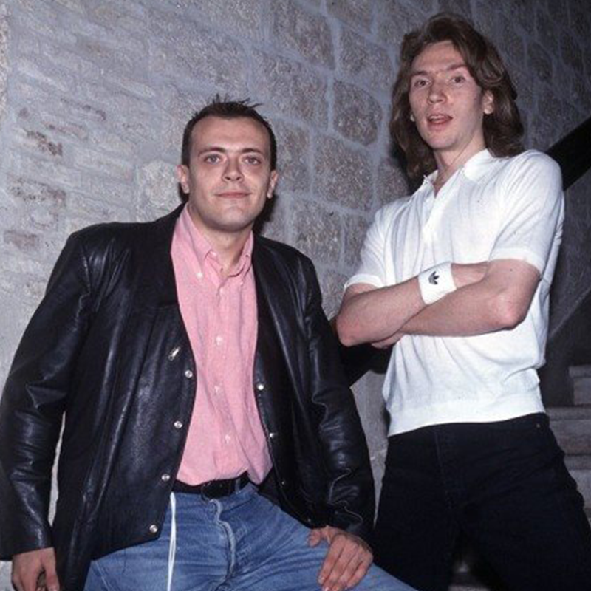
Our Players
Max Pezzali (BLACK)
Mauro Repetto (WHITE)

Slide 5
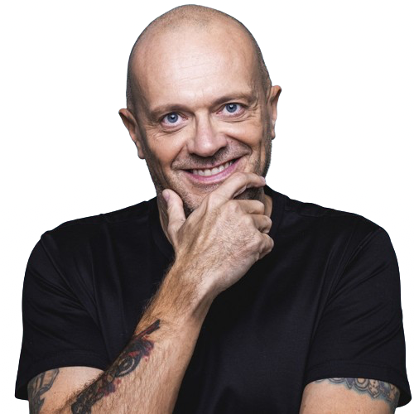
Black’s Heuristic
Our evaluation is based on:
Strategic Positions
Number of Black Pawns
Number of White Pawns
King’s Position
Check Sides
Average Black Pawns Distance from the King

Slide 6
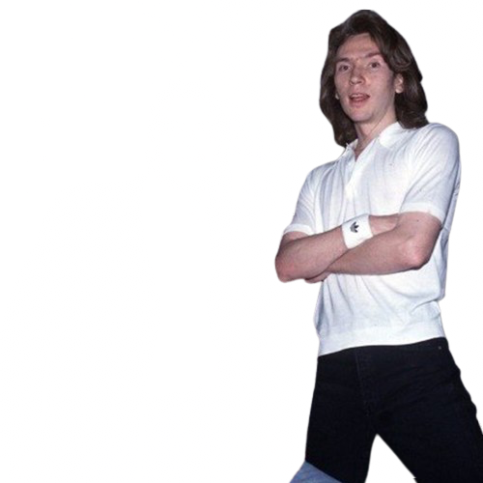
White’s Heuristic
Our evaluation is based on:
Number of White Pawns
Density of Black Pawns
King Distance from Exits
Check White Pawns sides
Strategic Positions
Pawns
King

Slide 7
Thanks for your attention!

